Slide 1
FORM VALIDATION
Server Side

Slide 2
TOPICS TO BE COVERED
  INTRODUCING SERVER SIDE VALIDATION
  CHECKING EMPTY FIELDS
  CHECKING FIELD LENGTHS
  CHECKING RANGES
  CHECKING FORMATS with Regular Expressions

Slide 3
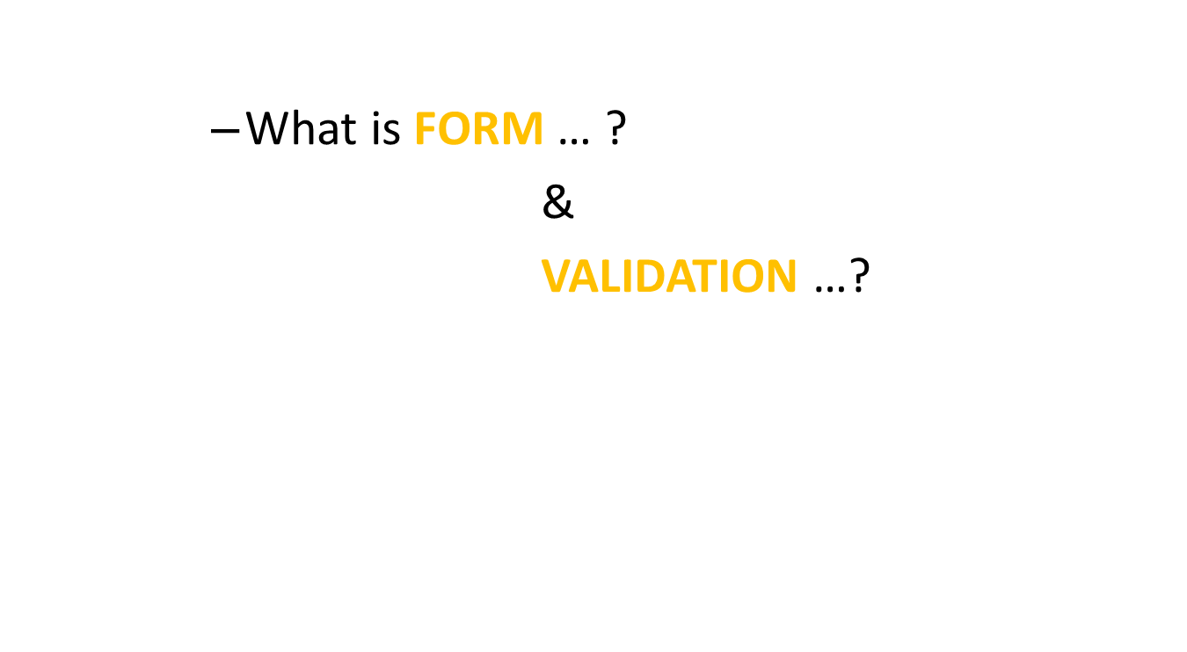
INTRODUCING SERVER SIDE VALIDATION

Slide 4
INTRODUCING SERVER SIDE VALIDATION
  The act of validating: finding or testing the truth of something.
  The act of declaring or making legally valid
  Validation is the process of checking if something satisfies a certain standard/ criteria.

Slide 5
INTRODUCING SERVER SIDE VALIDATION
  Form validation is the process of checking that a form has been filled in correctly before it is processed.
  For example, if your form has a box for the user to type their email address, you might want your form handler to check that they've filled in their address before you deal with the rest of the form
  There are two main methods for validating forms: server-side (using Common Gateway Interface (CGI) scripts, ASP, etc ), and client-side (usually done using JavaScript). Server-side validation is more secure but often more tricky to code, whereas client-side (JavaScript) validation is easier to do and quicker too (the browser doesn't have to connect to the server to validate the form, so the user finds out instantly if they've missed out that required field!).

Slide 6
INTRODUCING SERVER SIDE VALIDATION
  Server-side data validation means using PHP to verify that valid information has been sent to the script. Using server-side validation has pretty much the exact opposite process and cons of client-side development: it is more secure and works seamlessly
  with all browsers, but it does so at the cost of slightly higher server load and slower
  feedback for users.

Slide 7
CHECKING EMPTY FIELDS
  Users are irritating.
  They don't like filling out forms, and will tear through them as fast as they possibly can to get to the fun part of your site.
  Since they are typing so fast, they probably won't read the directions and sometimes they leave the fields blank and submit the forms.
  To avoid inserting blank fields in the data base, we bind them to fill all the required fields

Slide 8
CHECKING EMPTY FIELDS
<?php
$var = "";
if( empty($var ) )
{
echo "The variable is empty";
}
else
{
echo "The variable is having some value";
}
?>

Slide 9
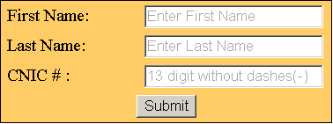
ASSIGNMENT
Enter Last Name
Enter Name
Enter CNIC number without using (-) signs
Please fill the field

Slide 10
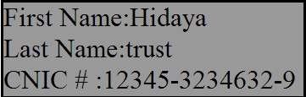
OUTPUT

Slide 11
REGULAR EXPRESSION
      What are They…?

Slide 12
REGULAR EXPRESSION
  A regular expression is a specific pattern that provides concise and flexible means to "match" (specify and recognize) strings of text, such as particular characters, words, or patterns of characters.
  Common abbreviations for "regular expression" include regex and regexp.
  They used to only be familiar to Unix users
  A regular expression provides a grammar for a formal language

Slide 13
REGULAR EXPRESSION
  There are 2 types of regular expressions:
    1) POSIX (Portable Operating System Interface for Unix)
    2) PCRE (Perl Compatible Regular Expression)
  The ereg , eregi , ... are the POSIX versions.
  The preg_match, preg_replace, ... are the Perl version.
  It is important that using Perl compatible regular expressions the expression should be enclosed in the delimiters, a forward slash (/). However this version is more powerful and faster as well than the POSIX one.

Slide 14
REGULAR EXPRESSION PCRE (Perl Compatible Regular Expression)
  We will be using PCRE.
  When using the PCRE functions, it is required that the pattern is enclosed by delimiters.
  A delimiter can be any non-alphanumeric, non-backslash, non-whitespace character.
  Often used delimiters are forward slashes (/), hash/number signs (#) and tildes (~).
  The pattern should be written inside double quotation(“ ”)

Slide 15
REGULAR EXPRESSIONS syntax
[abc] | a, b, or c
[a-z] | Any lowercase letter
[^A-Z] | Any character that is not a uppercase letter
[a-z]+ | One or more lowercase letters
[0-9.-] | Any number, dot, or minus sign
^[a-zA-Z0-9_]{1,}$ | Any word of at least one letter, number or _
[^A-Za-z0-9] | Any symbol (not a number or a letter)
([A-Z]{3}|[0-9]{4}) | Matches three letters or four numbers

Slide 16
PATTERN SWITCHES
  use switches to make the match global or case- insensitive or both: Switches are added to the very end of a regular expression.
Property | Description | Example
i | Ignore the case of character | /The/i matches "the" and "The" and "tHe"

Slide 17
PHP FUNCTION Preg_match()
  This function matches the value given by the user and defined in the regular expression.
  If the regular expression and the value given by the user, becomes equal, the function will return true, false otherwise.
  Syntax:
    Preg_match( $Pattern , $Subject , $regs )
  Pattern – Pattern is used to search the string.
  Subject – input given by the user.
  Regs
    If matches are found for parenthesized substrings of pattern and the function is called with the third argument regs, the matches will be stored in the elements of the array regs.

Slide 18
PHP FUNCTION Preg_match()
Literal Characters match themselves.
  The Carrot / Circumflex Sign ^
    Means string must start with.
  preg_match( “ /^hidaya/ ” , “ hidaya trust ” )
  The Dollar $ sign
    Means string must end with.
  preg_match( “ /hidaya$/ ” , “ hidaya trust ” )
  The Period . sign
    Means match any charcter.
  preg_match( “ /^d.r/ ” , “ dear ” )

Slide 19
PHP FUNCTION Preg_match()
<?php
$date = "2012-2-3";
$regs = "-";
if ( preg_match ( “/([0-9]{4})-([0-9]{1,2})-([0-9]{1,2})/ ", $date, $regs ) ) {
echo "$regs[3].$regs[2].$regs[1]";
}
else
{
echo "Invalid date format: $date";
}
?>

Slide 20
PHP FUNCTION Preg_match()
<?php
$pattern = "/^[A-Za-z ]{1,}$/";
$subject = "Hidaya Trust";
if (preg_match( $pattern , $subject ) )
{
echo "Pattern Matched";
}
else
{
echo "Pattern Mismatched";
}
?>

Slide 21
PHP FUNCTION Preg_match()
<?php
$pattern = "/^[A-Z ]{1,}$/i";
$subject = "hidayatrust";
if (preg_match( $pattern , $subject ) )
{
echo "Pattern Matched";
}
else
{
echo "Pattern Mismatched";
}
?>
  The case of characters will be ignored by the pattern
  It will match only the required pattern

Slide 22
PHP FUNCTION Preg_match()
<?php
$pattern = "/^[A-Z ]{1,}\.$/i";
$subject = "hidaya trust.";
if (preg_match( $pattern , $subject ) )
{
echo "Pattern Matched";
}
else
{
echo "Pattern Mismatched";
}
?>
  It will match only the required pattern
  The dot(.) is compulsory in the end of the string

Slide 23
PHP FUNCTION ereg( )
  Searches a string for matches to the regular expression given in pattern in a case-sensitive way.
  Syntax
  ereg ( $pattern , $string [, array &$regs ] )
  pattern : Case sensitive regular expression (string).
  String: The input string.
  Regs: If matches are found for parenthesized substrings of pattern and the function is called with the third argument regs, the matches will be stored in the elements of the array regs.

Slide 24
PHP FUNCTION ereg( )
<?php
$date = "2012-3-22";
$regs = "-";
if (ereg ( "([0-9]{4})-([0-9]{1,2})-([0-9]{1,2})", $date, $regs)) {
echo "$regs[3].$regs[2].$regs[1]";
}
else
{
echo "Invalid date format: $date";
}
?>

Slide 25
PHP FUNCTION preg_replace()
  This function performs the search and replaces the string.
  It works like str_replace()
Syntax
  preg_replace ( $Pattern , $Replacement, String / Array )
  Pattern : It is used to search for. It can be either a string or an array with string.
  Replacement : The string or an array with string to replace. If this parameter is a string and the pattern parameter is an array, all pattern will be replace by that string. If both pattern and replacement parameters are arrays, each pattern will be replaced by the replacement counterpart. If there are fewer elements in the replacement array than in the pattern array, any extra pattern will be replaced by an empty string.
  String/Array – input given by the user

Slide 26
PHP FUNCTION preg_replace()
<?php
$pattern= "/trust$/";
$replacement = "foundation";
$string = "hidaya trust";
echo preg_replace($pattern , $replacement , $string );
?>

Slide 27
PHP FUNCTION preg_replace()
<?php
$pattern = "/^[a-z ]+$/";
$string = "hidaya trust";
$a = preg_match ( $pattern, $string );
if($a)
{
$replacement = "foundation";;
$patt = "/trust/";
echo preg_replace($patt , $replacement , $string );
}
?>

Slide 28
CHECKING FIELD LENGTH
  To restrict the users to fill the forms within the boundary of the requirements
  To implement server-side validation, we write a PHP script that handles the validation and then process the data accordingly.
  The user will be bound to enter data within the limit.
  You are very familiar to string functions, they are utilized in the validation section

Slide 29
CHECKING FIELD LENGTH
$text = "Fah123";
$pattern= "/^[0-9a-zA-Z]{6}$/";
echo preg_match($pattern , $text);
Or
$text= "123456";
$pattern="/^[0-9]{6}$/";
echo preg_match($pattern , $text);

Slide 30
CHECKING FIELD RANGES
  Checking the field ranges is one of the important part of the validation.
  The user has to insert the data in between the range of the defined length.
<?php
$text="123456789012";
$pattern="/^[0-9]{6,12}$/";
echo preg_match( $pattern , $text );
?>

Slide 31
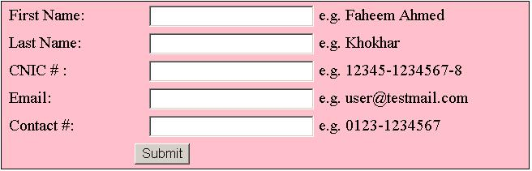
ASSIGNMENT
Message should be displayed, if pattern does not match criteria

Slide 32
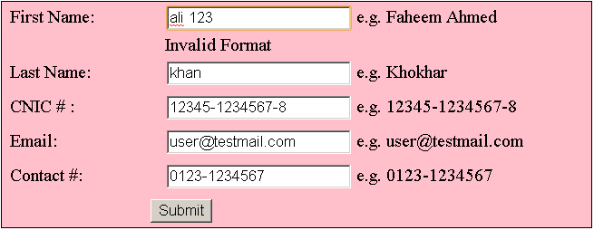
INPUT
Message should be displayed, if pattern does not match criteria

Slide 33
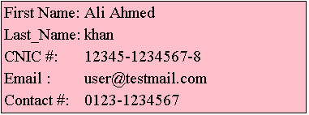
OUTPUT

